Slide 1
Software and systems engineering
Paulo Borba
Informatics Center
Federal University of Pernambuco
phmb@cin.ufpe.br ◈ twitter.com/pauloborba

Slide 2
To do before class
Watch video
Read related parts of chapters 7 and 10 in the textbook
Send questions and opinions through slack

Slide 3
Project management 1, time and scope

Slide 4
To deliver the required software and system, we have to specify, implement and test the needed features…

Slide 5
That often is a lot of work, carried on by a number of people, so we better get organized!

Slide 6
We need to control interdependent dimensions:
scope (+)
quality (+)
time (-)
costs (-)

Slide 7
quality x cost/time
scope x cost/time
scope x quality
time x cost
Notes:
MEXER NO EIXO Y

Slide 8
Scope

Slide 9
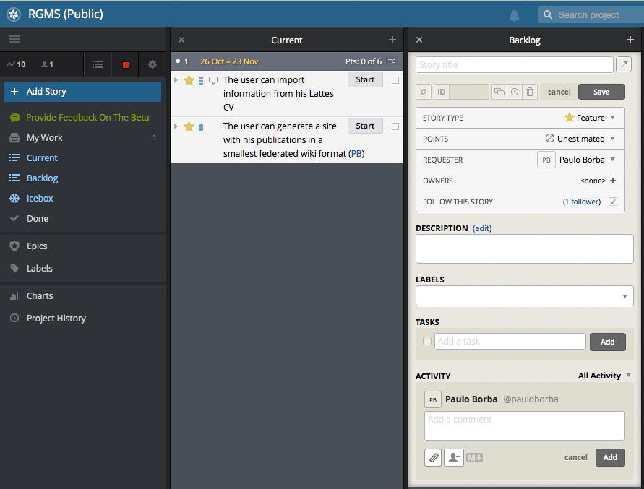
To control scope, we need to manage a list of tasks

Slide 10
Tasks
Fix a bug
Implement a new scenario or feature
Change the implementation of an existing feature
Refactor
Improve performance
Study, investigate, prepare, organize, etc.
Notes:
Features are stories that provide verifiable business value to the team's customer (e.g., "Add a Special Instructions field to the checkout page," "Purchase history should load in half a second," and "Add a new method addToInventory to the public API"). Features are worth points and therefore must be estimated.
Chores are stories that are necessary but provide no direct, obvious value to the customer (e.g., "Sign up for access to geocoding service" and "Find out why the detailed test suite takes so long").
Bugs represent unintended behavior that can be related to features (e.g., "Login box is wrong color" or "Price should be non-negative").
Releases are milestone markers that allow your team to track progress towards concrete goals (e.g., stakeholder or investor demos, software launches, etc.). It's possible to specify target dates for releases (more on those below). All stories for a milestone or release should go above the marker for it.

Slide 11
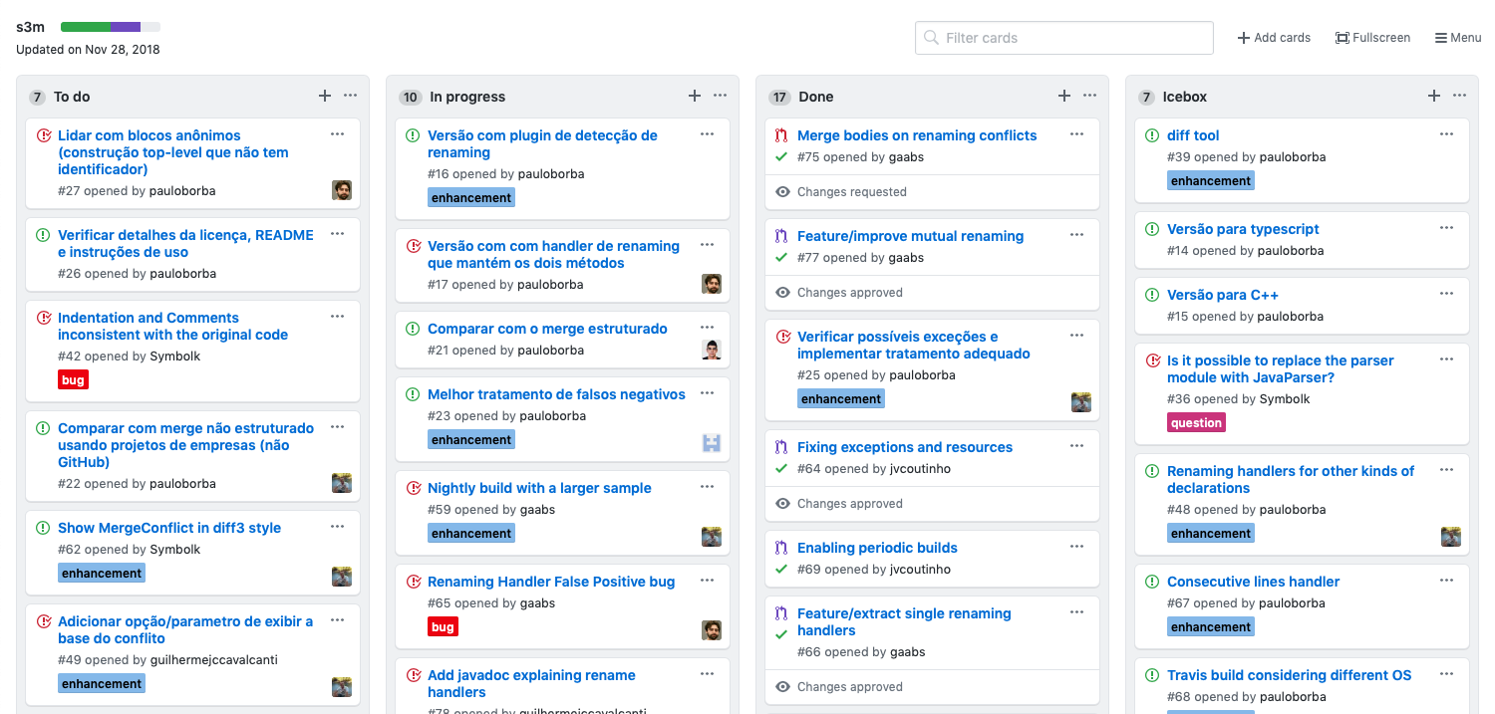
Lists of tasks, really

Slide 12
For early and recurrent delivery and feedback, tasks are grouped in iterations (sprints)
Notes:
figura

Slide 13
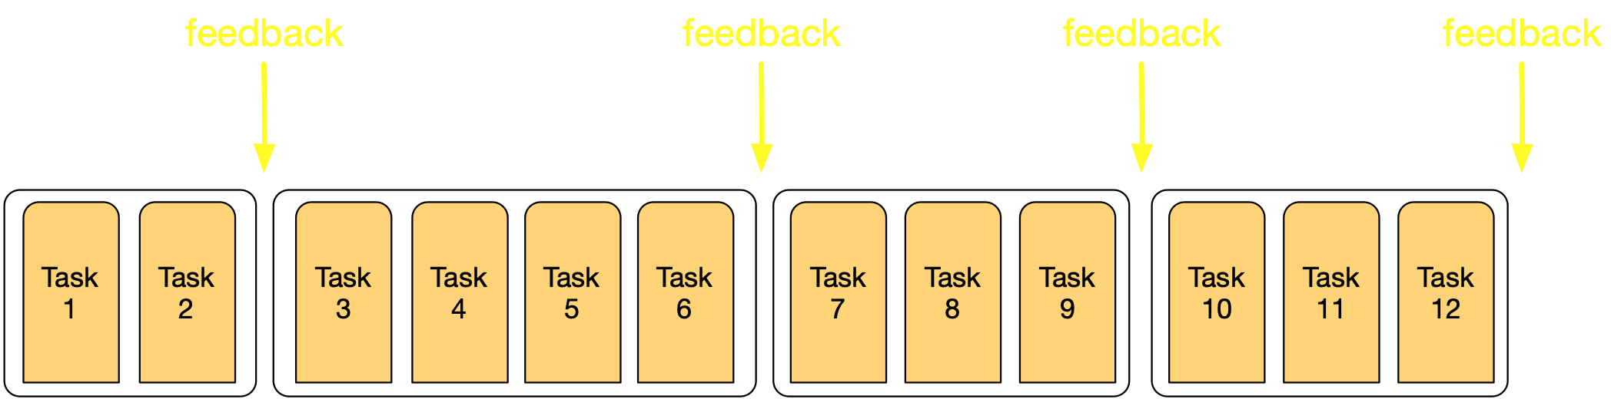

Slide 14
Iterations
are defined by a (sprint) backlog, accordingly to stakeholders' priorities
last from one to four weeks
incrementally develop the system
assign each task to a team member (owner)
perform tasks in 4 to 16 hours

Slide 15
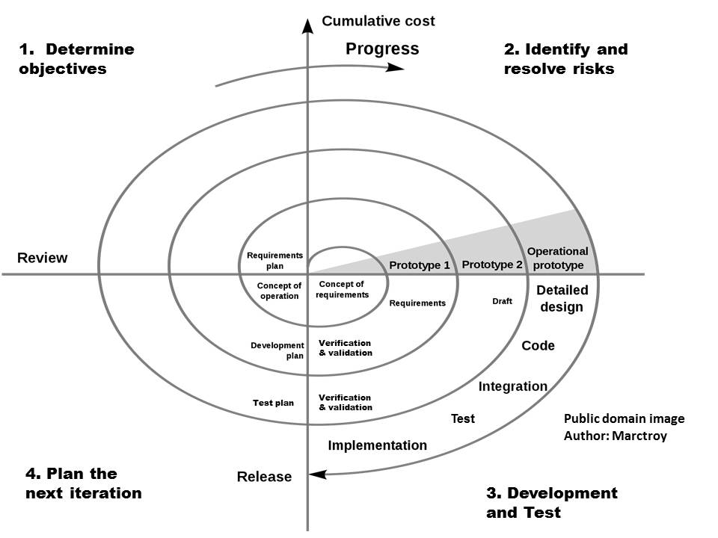
Software development models, spiral
http://ultimatesdlc.com/spiral-model/?share=press-this

Slide 16
Diverse processes and domains
Web systems
Mobile applications
Embedded software
Startups
Information systems
Banks
Google/Facebook/Microsoft/Amazon

Slide 17

Software development models, waterfall and V
http://04126030sasd.blogspot.com/2011/07/waterfall-model.html
misinterpreted!
http://crackmba.com/v-shaped-model/
Notes:
pegar foto do paper do waterfall

Slide 18
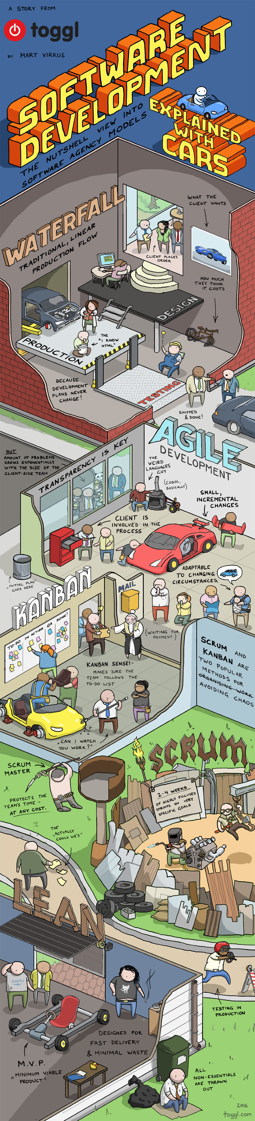

Slide 19
https://toggl.com/developer-methods-infographic

Slide 22
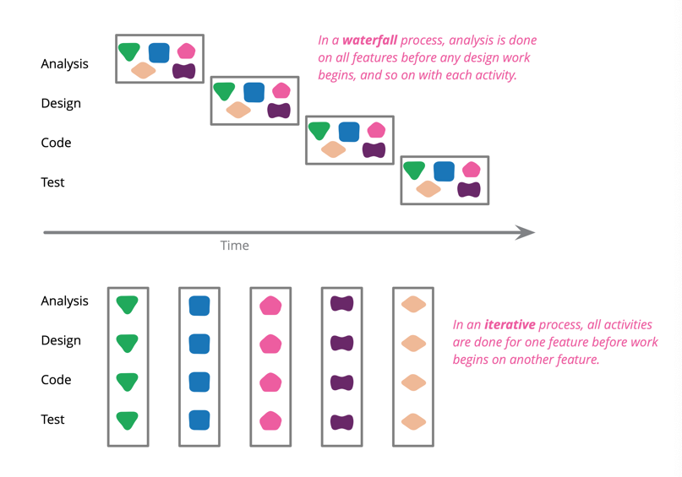
https://martinfowler.com/bliki/WaterfallProcess.html
Notes:
https://martinfowler.com/bliki/WaterfallProcess.html

Slide 23
Time

Slide 24
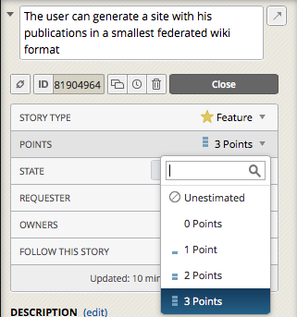
To control time, we need to manage task estimations…
story = task
Notes:
The user who created the story becomes the "requester", but that can be set to any project member. Ideally, this is someone who speaks for (or is) the project's customer, and can make decisions about story requirements and acceptance criteria.
The owner is the person who will be responsible for implementing the story (normally a developer). It's not necessary to identify an owner when the story is initially created - Tracker allows anyone to start a story. On a typical project, team members start stories from the current iteration (or the top of the backlog) when they finish work on the last story.

Slide 25
Estimating by
allocating points to tasks
starting with a simpler three-point scale
ground in concrete situation (work done in an ideal day)
measuring the number of points per iteration
finding out team velocity (the average number of points per iteration)
Notes:
Figura, exemplos
When starting out with Tracker, it helps to ground a point in something concrete (e.g., how much can be done in an ideal day, or a typical small feature).

Slide 26
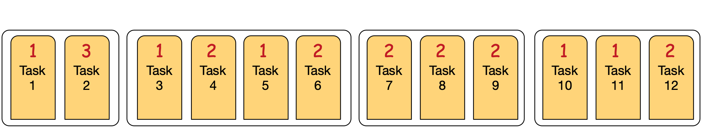

Slide 27
Focus on development effort, not time

Slide 28
Main purpose is to help make decisions, not be used as firm deadlines
Notes:
https://martinfowler.com/bliki/PurposeOfEstimation.html

Slide 29
Product backlog
tasks with requester, estimation and priority
created by the product owner (represents stakeholders interests)
never complete, changed as needed by any team member
priority tasks described in more detail
epics help associate tasks to macro features

Slide 30
Allocating tasks in a iteration considering
priorities (focus on business value)
risks (more significant risks should be addressed first)
team expertise (should match allocation)
dependencies and potential conflicts (should be avoided)
estimation and velocity
Notes:
exemplo com calculo da media (prioritaria), auto-avaliacao (depende da de media), importação de excel com alunos e conceitos (arriscada, api nova para ler excel), importação de json (conflito com excel, especialista em parse de json ainda não alocado), etc.

Slide 31
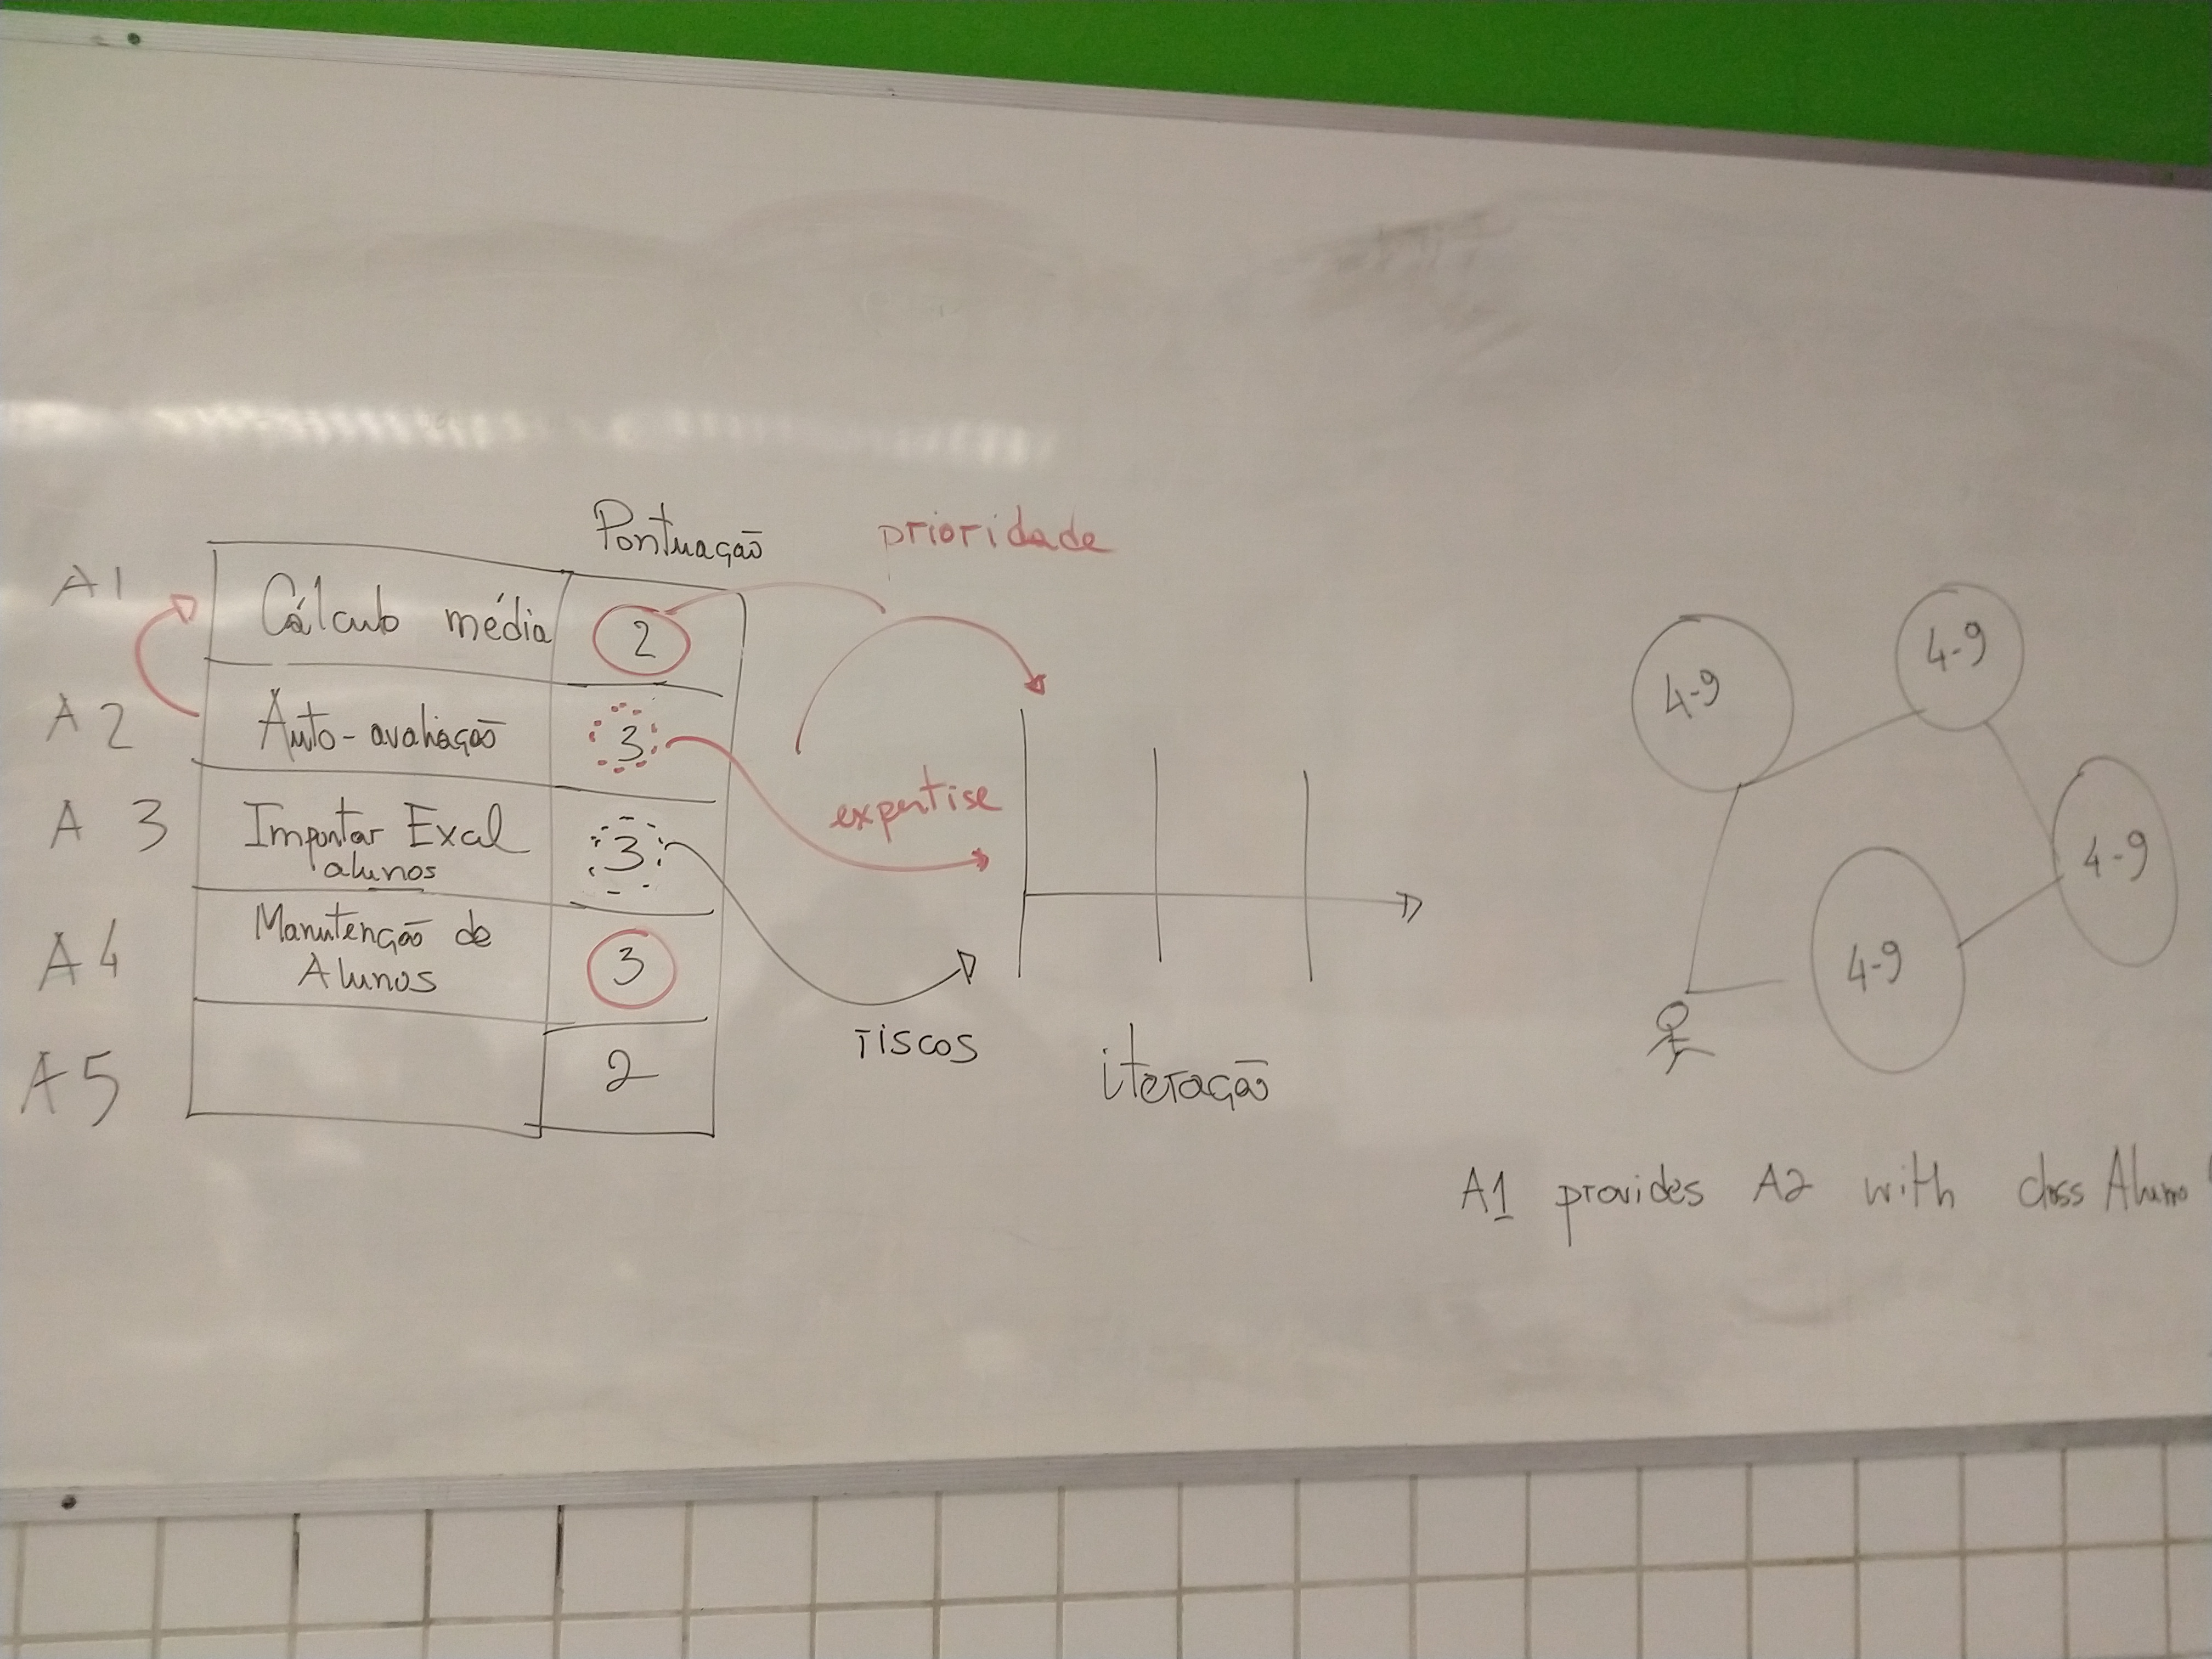

Slide 32
Planning game
negotiation between business priorities and technical priorities and estimations
business people define
releases, dates, scope, priorities
technical people define
estimations, process, detailed release schedule

Slide 33
Take notes, now!

Slide 34
Hands on exercises
Notes:
Indo de aluno por aluno, verificando o progresso, e registrando como comentário no assignment do classroom.

Slide 35
Project management 1

Slide 36
Project management 1I, team and collaboration
Notes:
reforçar estória e conexão entre os slides nessa aula. ainda muitas bullets.

Slide 37
Team size
4 to 9 people
common organization at Pivotal:
six software engineers, an interaction designer, and a product manager

Slide 38
Roles at Pivotal
Interaction designers
requirements elicitation and validation; visual design
Product managers
feature identification and prioritization, requirements specification, planning, and communicating specifications to engineers
Software engineers
implement the solution and test

Slide 39
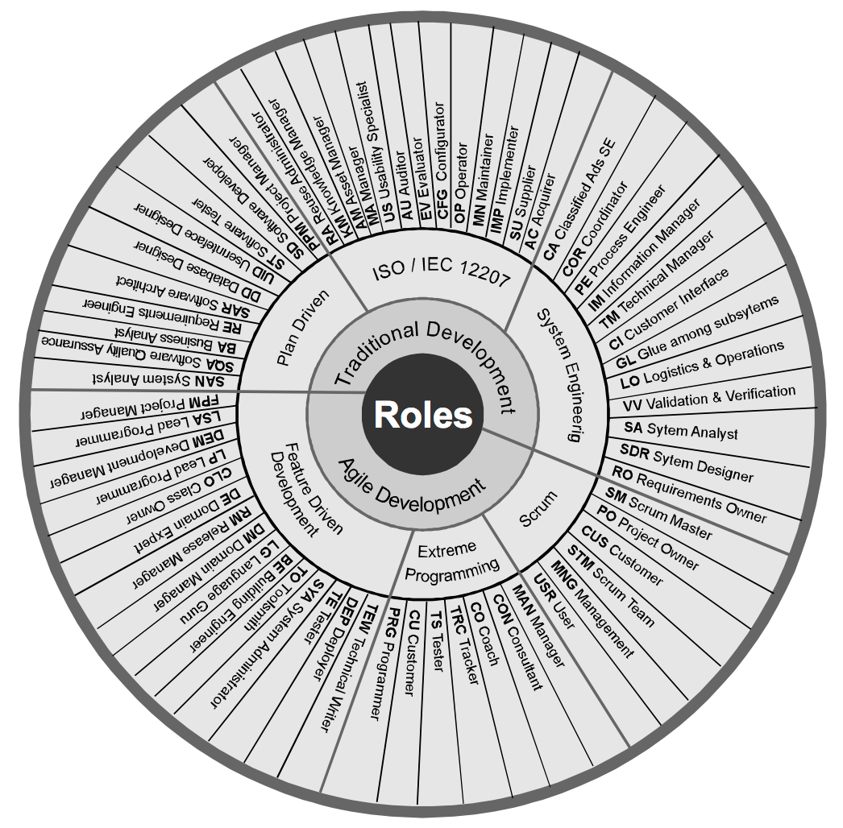
Unknown source

Slide 40
Common desired skills
Communicate precisely
Divide work
Manage complexity
Understand, choose and use proper tools
Understand social context

Slide 41
Choosing people for the team and each task
Considering a number of aspects:
technical,
experience,
collaboration, and
personality dimensions

Slide 42
Team dynamics are complex and managing people is difficult

Slide 43
Planning and increasing team awareness
run daily (scrum) meetings (15 min)
done? to do? obstacles?
planning meetings
defines priorities and sprint contents and deadlines
triage

Slide 44
Scrum meeting benefits and drawbacks
information sharing, improves collaboration and coordination, team awareness, avoids conflicts, or reveal them earlier
opportunity to discuss and solve (very quickly) problems
team cohesion, spirit, culture and training
boring status reporting (just drop one of the questions)
too frequent and too long (just reduce frequency)
disruptive, interruption (as any meeting, no solution)
delay to start, to finish (just develop culture)

Slide 45
Continuously improving
review meetings
discuss implemented features in a sprint, and changes to the product backlog
retrospective meetings
discuss good and bad aspects of a sprint
facilitated by the Scrum master
Notes:
Meetings are necessary for teamwork to be successful (Kauffeld and Lehmann-Willenbrock, 2012). They provide a venue for information exchange, decision making, coordination, planning and monitoring progress, each of which is an essential component of the team processes associated with team performance (O’Neill and Allen, 2012).

Slide 46
Retrospectives at Pivotal
emotion-based retro format with “happy” (working well), “neutral” (should monitor) and “sad” (problem to fix) faces columns
any team member can add any topic to any column
the team dot-votes on the topics to discuss
topics are discussed (60 minutes) and action items are created
Notes:
The dot-voting process includes the following steps:
Participants are each given a set number of dot stickers (as decided by the facilitator)
They place dot stickers next to options presented that they like (they may place any number of their dots on any number of the options)
Options with the most dots at the end of voting “win”
Variations include:
using different colour dots to signify different values, e.g. green for "like" and red for "dislike".
using different colour dots for different types of participants e.g. blue for management and red for staff.

Slide 47
Minimizing team member conflicts and development effort
Define task interfaces
Need to change interfaces should be first discussed
Same approach for the need to add new interfaces
Automated testing

Slide 48
Broader notion of interface

Slide 49
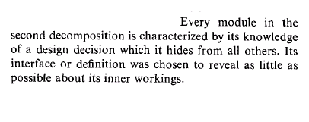

Information hiding and interfaces (David Parnas, CACM 1972)
Not necessarily
public methods!
Not necessarily
data representation!
Notes:
Generalize this for aspects… Exploiting the benefits of interfaces…

Slide 50
Interfaces as a means to achieve independent development
Notes:
CONECTAR MELHOR ISSO COMO PARTE DA DEFINICAO DA ARQUITETURA DO SISTEMA. DEIXAR CLARO ISSO AQUI E NOS SLIDES DE ARQUITETURA E PROJETO.

Slide 51
Which interface should we specify if we want to independently develop features for importing student data from a file, and registering students through a form?

Slide 52
Large systems and collaborating teams
Feature development and maintenance is performed by a team of developers from different component (subsystem) teams
Component teams specialise on the functionalities of a given component, and collaborate to the development of features that require functionalities related to that component

Slide 53
Take notes, now!

Slide 54
Hands on exercises
Notes:
Indo de aluno por aluno, verificando o progresso, e registrando como comentário no assignment do classroom.

Slide 55
Project management 1I

Slide 56
Project management 1II, quality and cost

Slide 57
Quality

Slide 58
To control quality, we need to…
test the system
review artifacts
pair programming
measure quality attributes
static analysis tools
reduce technical debt
Notes:
um slide para cada item!

Slide 59
Separate environments for different activities
Development
Testing (integration, system, etc.)
Daily build and smoke test
Execution (deployment)

Slide 60
Review (inspect) artifacts
in a tool
focus on most relevant points
guide yourself by clear goals (checklist)
be objective
be kind: critique the artifact rather than its author
be constructive

Slide 61
https://www.michaelagreiler.com/code-review-pitfalls-slow-down/

Slide 62
Requirements specification review
The specification is syntactically valid and can be executed by Cucumber tools
The specification is clear and has no English spelling and syntactic mistakes
The commits/PR clearly convey the intention of the change, and what has been changed
The specification conforms to the requirements specification checklist

Slide 63
Similarly for other software development artifacts: tests, code, design, documentation

Slide 64
Costs

Slide 65
cost estimation
=
team size and cost for a given period (no promises of delivered features)

Slide 66
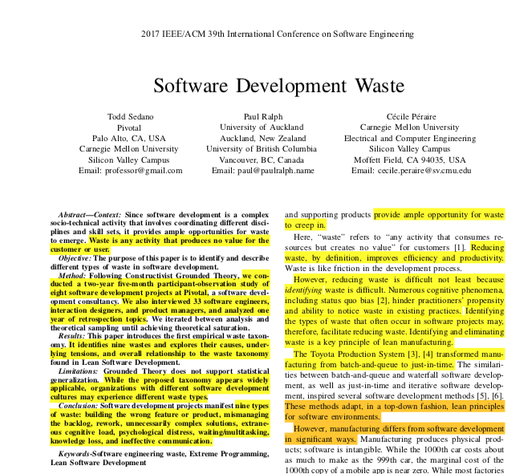
Fixing both scope and schedule is often antithetical for systems that are not similar to previously developed systems.
"The client either chooses the release date and gets only the features ready by then or chooses key features and ships the product when the features are ready."

Slide 67
To control costs, we need to…
control scope and quality, avoiding increased scope and quality expectations
control time, avoiding delivery anticipation
manage development productivity
team skills, tools
process, motivation
reducing waste

Slide 68
reducing waste (unnecessary activity that produces no value for the stakeholders) improves productivity, by definition
Notes:
olhar https://sedano.org/toddsedano/2017/07/14/sustainable-software-development-compared-to-extreme-programming.html

Slide 69
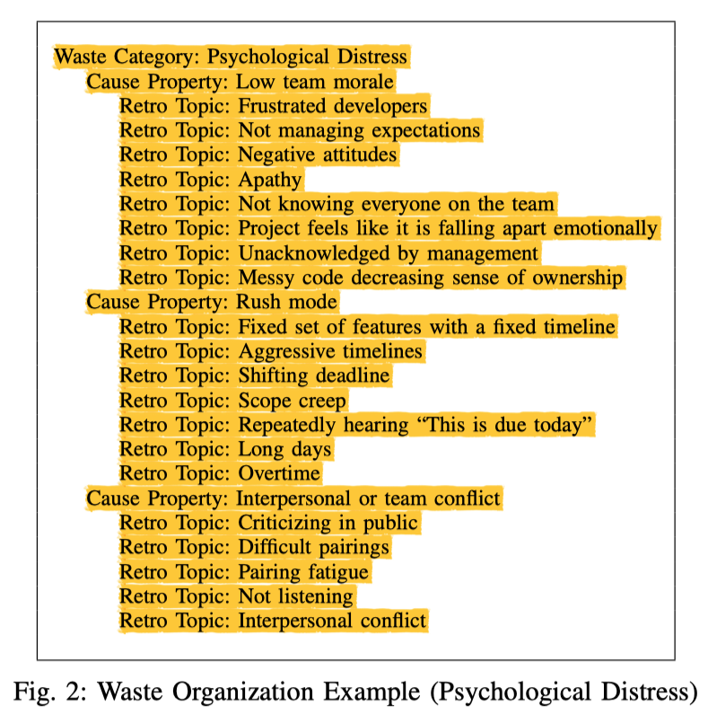
Notes:
desenhar teoria?

Slide 70
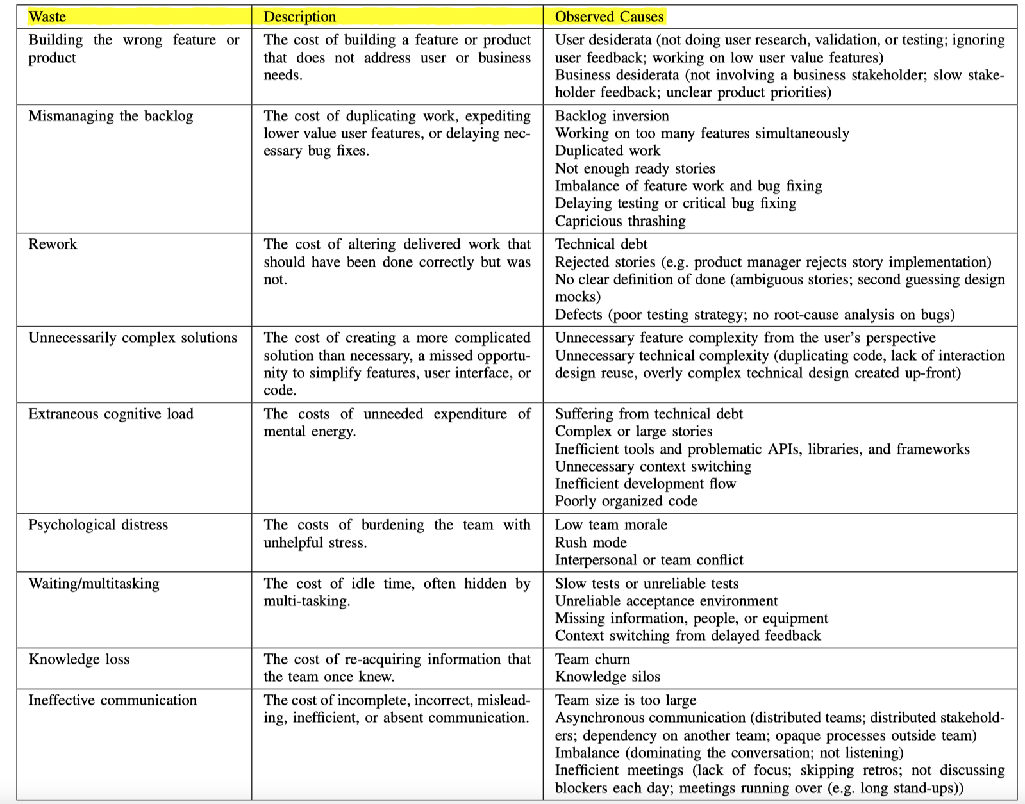
Notes:
pegar cada um dessas causas de waste e detalhar ela melhor na parte do curso que esta relacionada a ela. por exemplo, User desiderata deveria ser discutida em requisitos.

Slide 71
Brooks’ Law: adding people to a late project delays it further

Slide 72
The Shortest Possible Schedule law
https://bertrandmeyer.com/2019/11/01/theorem-software-engineering/
Notes:
https://bertrandmeyer.com/2019/11/01/theorem-software-engineering/

Slide 73
Notes:
decisão de aumentar o prazo, a direita do 1.0x1.0, pode levar a aumento ou redução do esforço
decisao de aumentar o esforco/investimento, a esquerda do 1.0x1.0, leva a redução do prazo, dentro de certo limites

Slide 74
you can, within limits, shorten delivery times by properly bringing people to the project

Slide 75
Checklist
Define tasks and epics with clear focus, and granularity corresponding to a group of related scenarios
Carefully estimate and measure velocity
Daily meetings (at least virtual meetings at the slack channel)
Plan ahead, early report delays

Slide 76
Take notes, now!

Slide 77
Hands on exercises
Notes:
Indo de aluno por aluno, verificando o progresso, e registrando como comentário no assignment do classroom.

Slide 78
Project management III

Slide 79
Project management research at CIn
Team motivation: Fabio
Software process: Alexandre Vasconcelos and Hermano
Task scheduling: Paulo

Slide 80
To do after class
Answer questionnaire (check classroom assignment), study correct answers
Finish exercise (check classroom assignment), study correct answers
Read, again, parts of chapters 7 and 10 in the textbook
Evaluate classes
Study questions from previous exams

Slide 81
Questions from previous exams
Como um gerente de projetos que segue metodologias ágeis, explique brevemente o que você faria para controlar o tempo de desenvolvimento de um software sob responsabilidade da sua equipe.
Explique brevemente o que é “velocity” e como a mesma pode ser usada para estimativas.
Quais as vantagens de desenvolver o software em iterações ou sprints curtas?
Explique quais as dimensões que um gerente de projeto tem que controlar, e cite duas consequências negativas de não conseguir controlá-las adequadamente?

Slide 82
Software and systems engineering
Paulo Borba
Informatics Center
Federal University of Pernambuco
phmb@cin.ufpe.br ◈ twitter.com/pauloborba

